Slide 1
Intro to Web Development
Cascading Style Sheets for designing Layouts

Slide 2
Agenda
What are layouts?
Understanding the CSS box
Significant Attributes
Hands on Layout

Slide 3
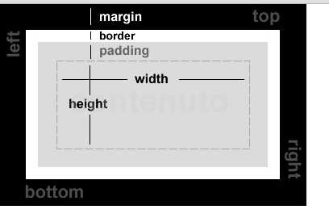
Layouts

Slide 4
Layout Terms
Positioning
position: absolute;
position: relative;
fixed, static and inherit
Absolute is from the top right of the viewport
Relative is in relation to it’s original position in the normal flow
Let’s see the demo

Slide 5
More layout terms
display: block – requires a new line
Cannot have items to it’s left of right
display: inline – displays content sidexside
Will have items to it’s right
clear – to prevent from floats left or right
left, right, both
overflow
visible, hidden, scroll, auto
Let’s see the demo

Slide 6
More Layout Terms
width
height
Can be in px or percentages
width: 300px or width: 90%;
max-height: 300px;
min-height: 500px;

Slide 7
Background Images
background-image: url(‘path/to/picture.jpg’)
background-repeat: repeat-x;
background-repeat: repeat-y;
background-repeat: no-repeat;
Let’s see the demo

Slide 8
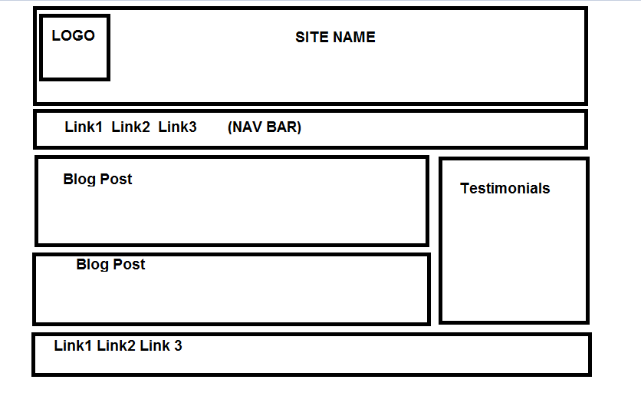
Let’s create a simple layout

Slide 9
Resources
Web Developer Toolbar
Google Chrome Browser Inspect Element
https://addons.mozilla.org/en-US/firefox/addon/web-developer/
Wc3schools http://www.w3schools.com
HTML5 and CSS3 7th edition Castro & Hyslop
Questions

